Slide 1
Optimizing Big Mountain Resort: A Data-Driven Approach
By Afnan Abdullahi

Slide 2
01:
The Problem

Slide 3


Problem Identification:
Operating Costs Surge
Big Mountain Resort Faces a significant increase in operating costs
An additional chair lift increasing $1.54 million in operating costs
Current Ticket Price: $81.00
Objective: Optimize Revenue
The goal is clear: optimize revenue while ensuring continued customer satisfaction
Notes:
Attribution:
Cogwheel Icon: <a href="https://www.flaticon.com/free-icons/operation" title="operation icons">Operation icons created by SBTS2018 - Flaticon</a>
Bullseye Icon:<a href="https://www.flaticon.com/free-icons/goal" title="goal icons">Goal icons created by Freepik - Flaticon</a>

Slide 4
02:
Findings + Modelling

Slide 5
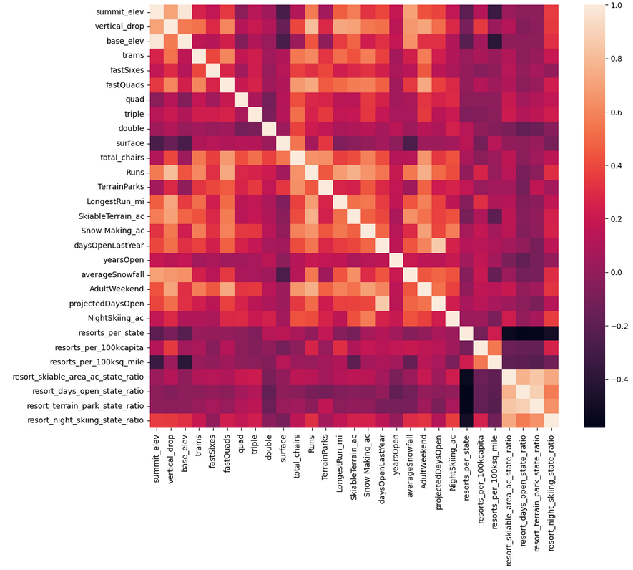
Key Features:
The heatmap visualization highlighted clear positive correlations:
fastQuads
Runs
SnowMaking_Ac
Night skiing ratio

Slide 6
Modelling Results:
Random Forest Model outperforms linear models
Cross-validation identified eight key features
The model highlights Big Mountain Resort’s exceptional standing in various categories
The model priced tickets at $96.62

Slide 7
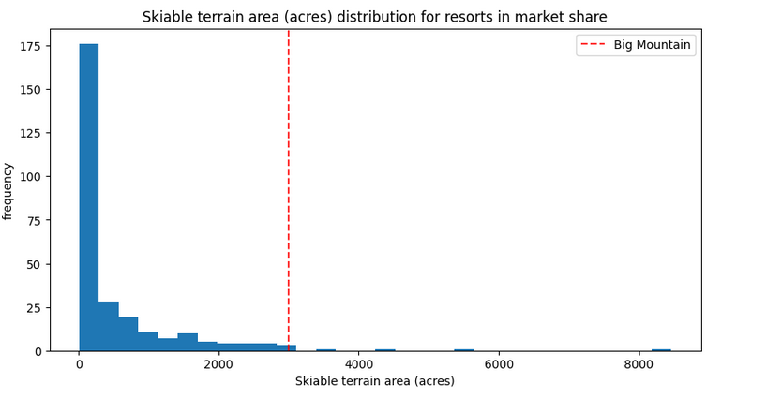
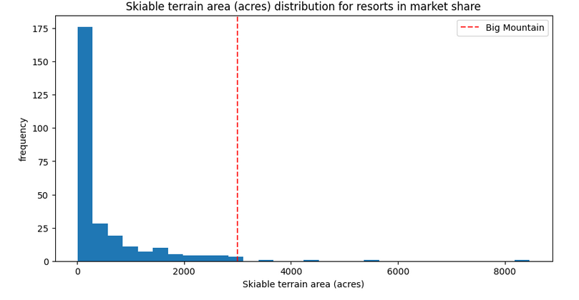
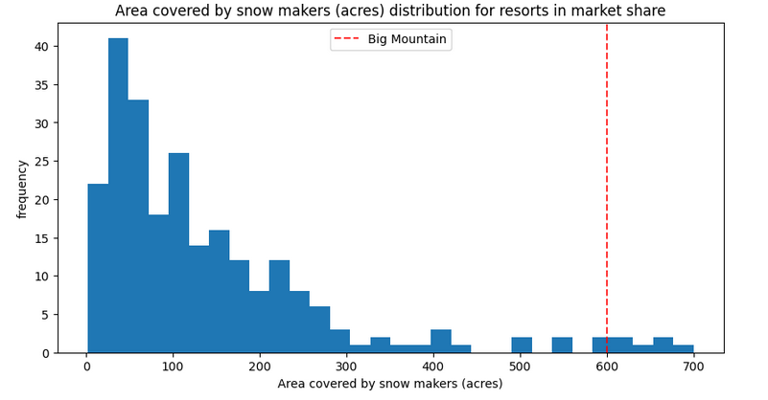
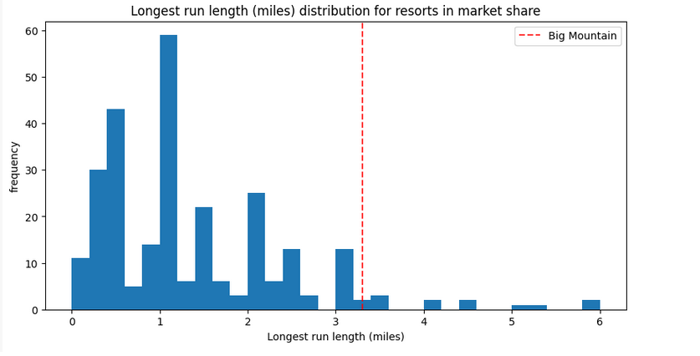
The accompanying bar charts highlighted the resort’s high standing during the model development phase.

Slide 8
03:
Recommendations

Slide 9
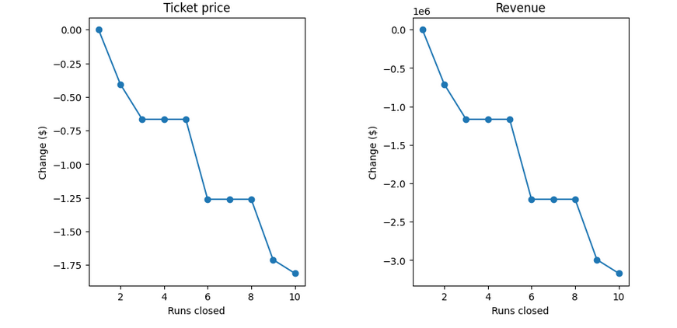
Recommendations:
Winning Model:
Scenario 3 proposes a ticket price increase of $13.22
Recommend closing of 6-10 underutilized runs
Reduction in vertical drop of 150 feet
Expand snowmaking cover by 2 acres

Slide 10
04:
Conclusion

Slide 11
Summary and Conclusion:
Big Mountain Resort holds exceptional standing in various categories highlighting the resort’s high standing.
The data exploration has provided insights into dynamic pricing strategies and influential features
Scenario 3 emerges as the preferred option for ticket price increase
Further work is necessary but these recommendation should increase Big Mountain Resort revenue and help reduce some costs.

Slide 12
THE END
Any Questions?

